Slide 1
Concurrency
Saint Petersburg, 2019

Slide 2
Content
1
Hardware basics
2
Software basics
3
Java thread management
4
Concurrency general concept
5
Java concurrency implementation
6
Conclusion

Slide 3
Hardware basics

Slide 4
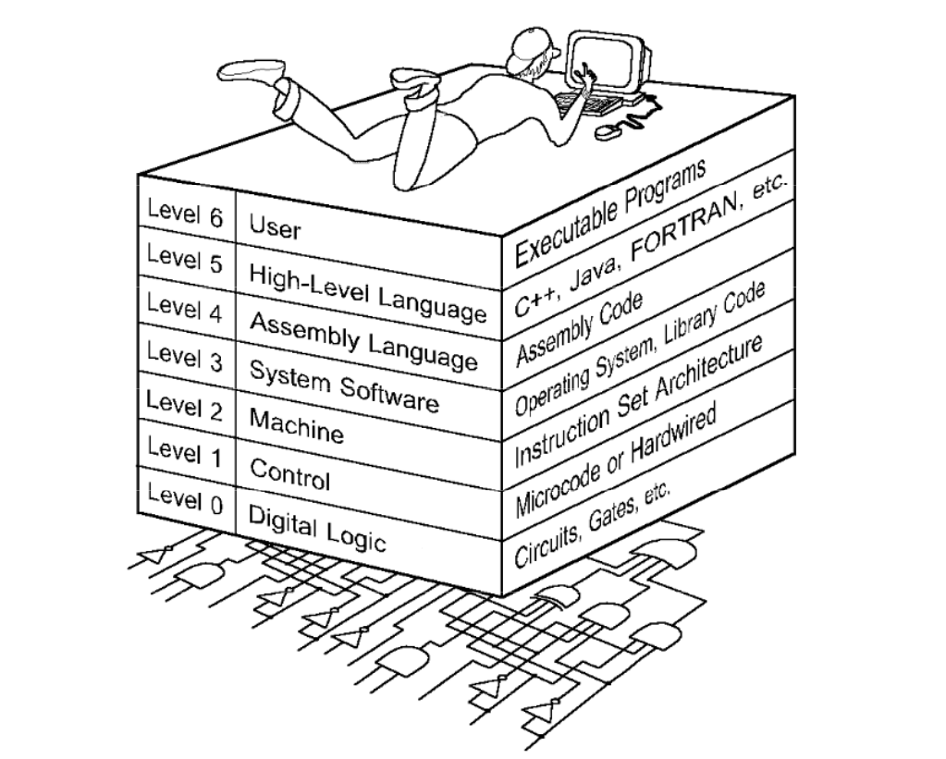
The World we are living in

Slide 5
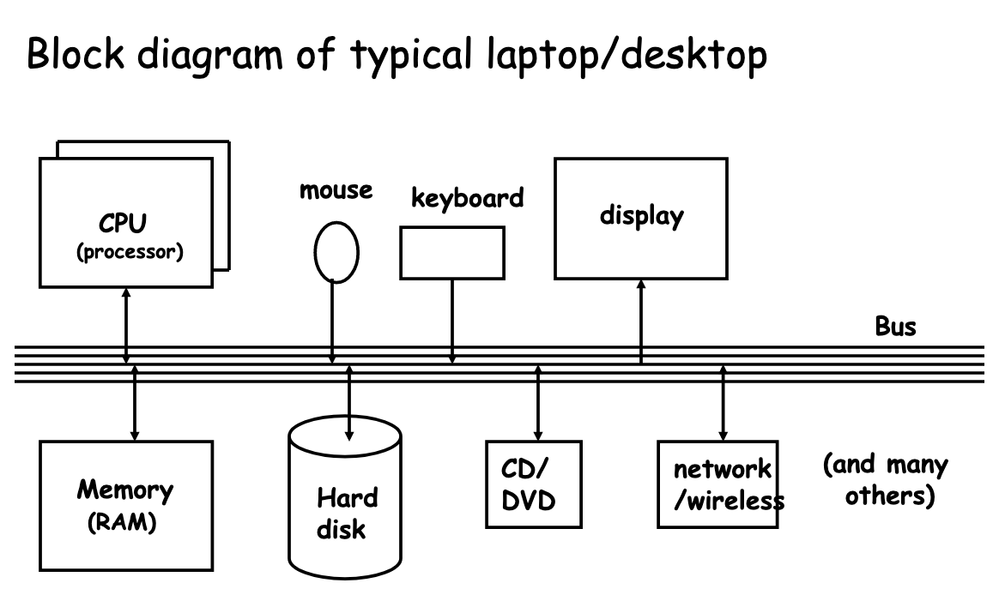
Computer architecture

Slide 6
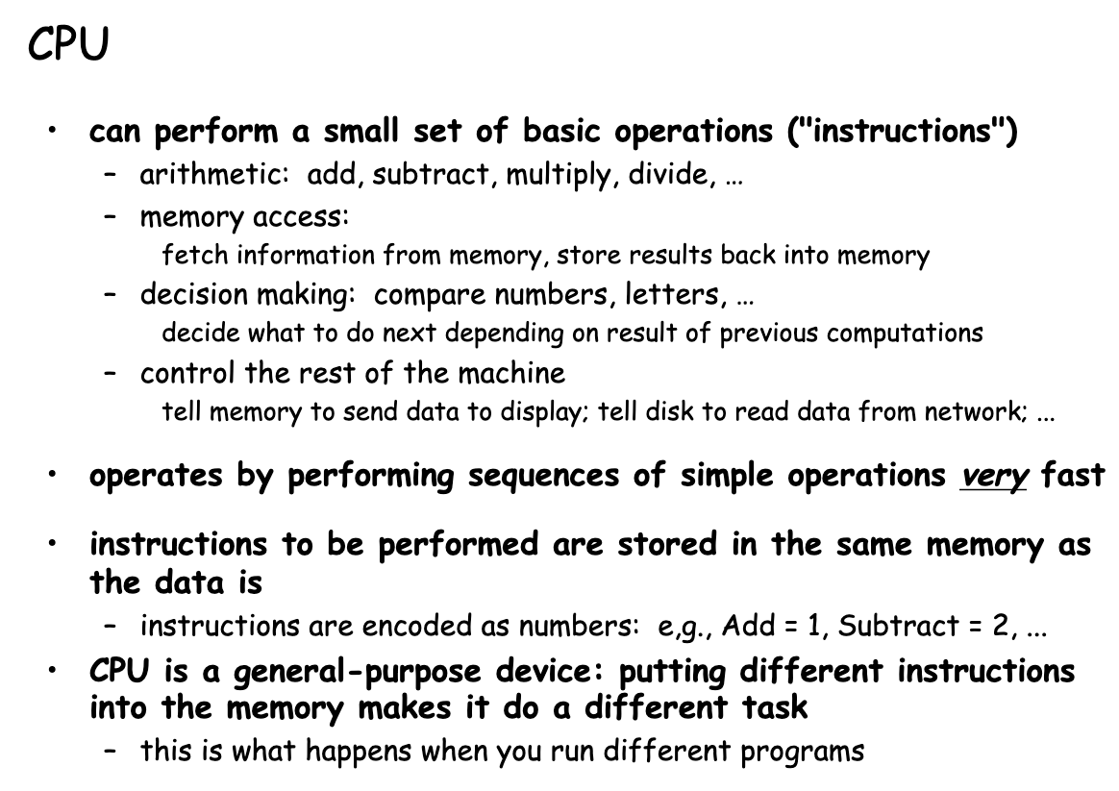
CPU

Slide 7
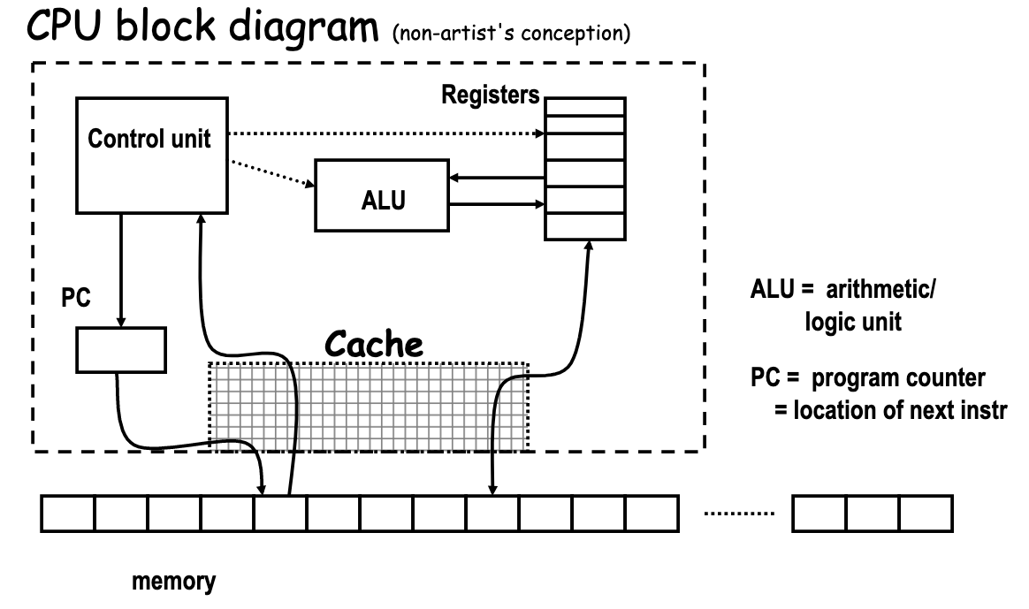
CPU

Slide 8
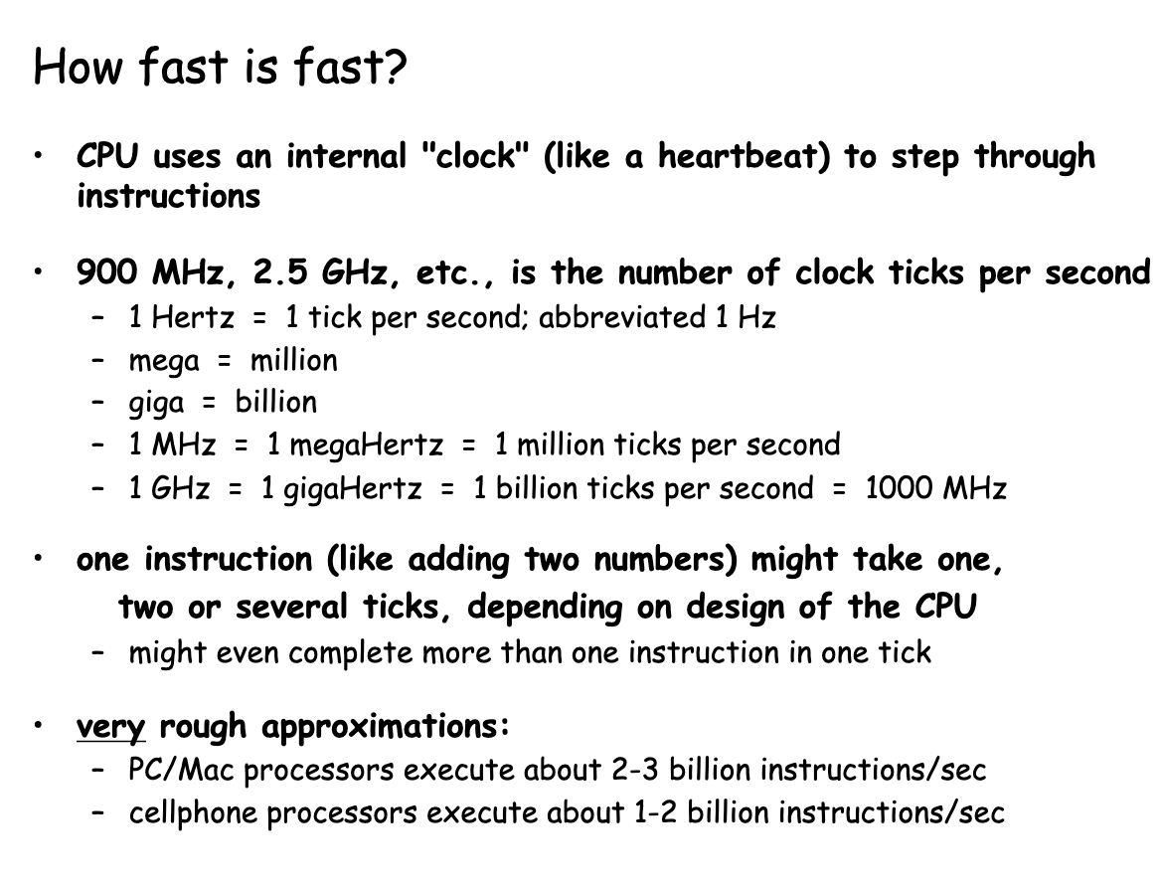
CPU

Slide 9
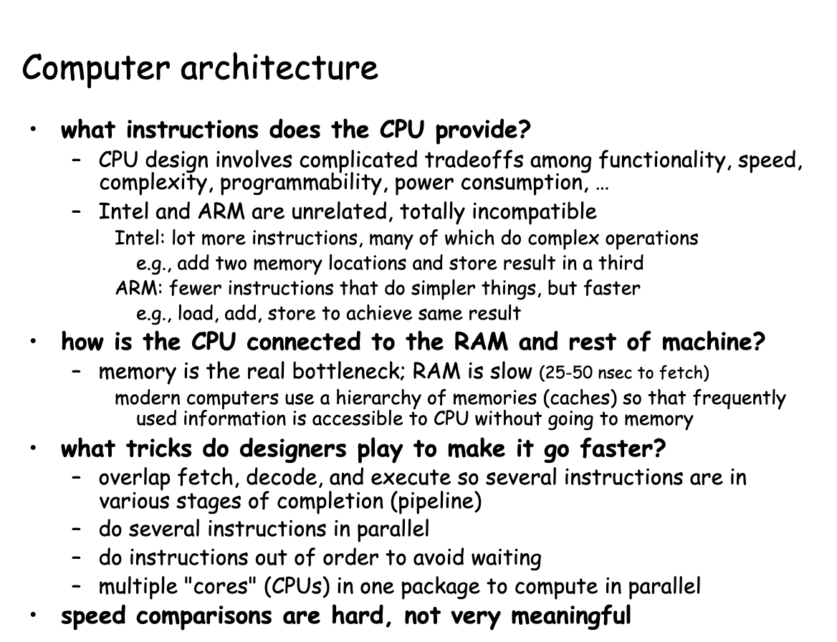
Computer architecture

Slide 10
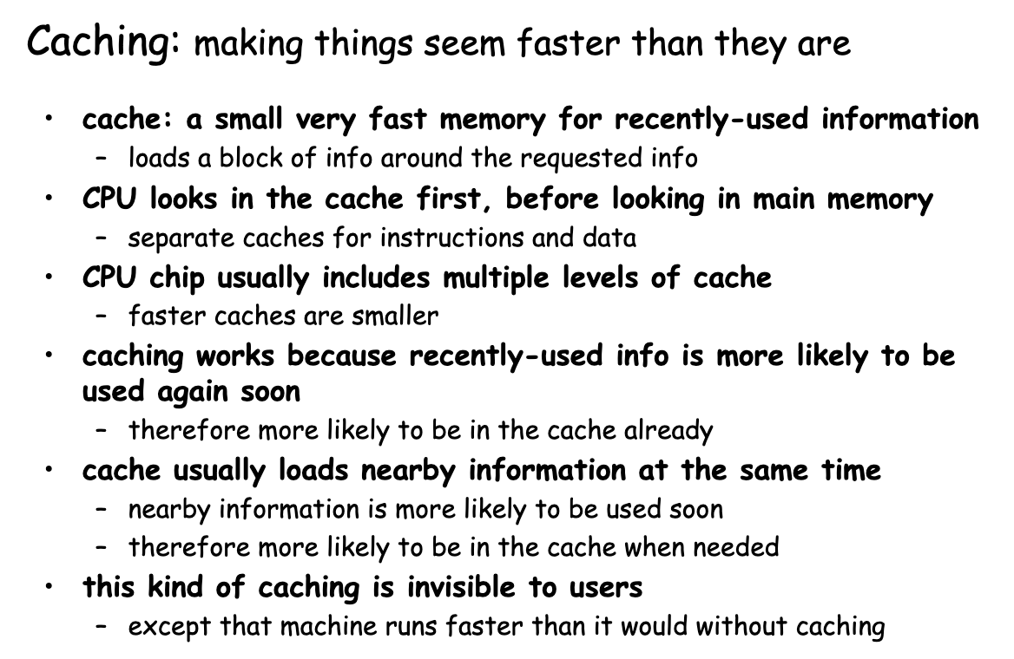
CPU architecture

Slide 11
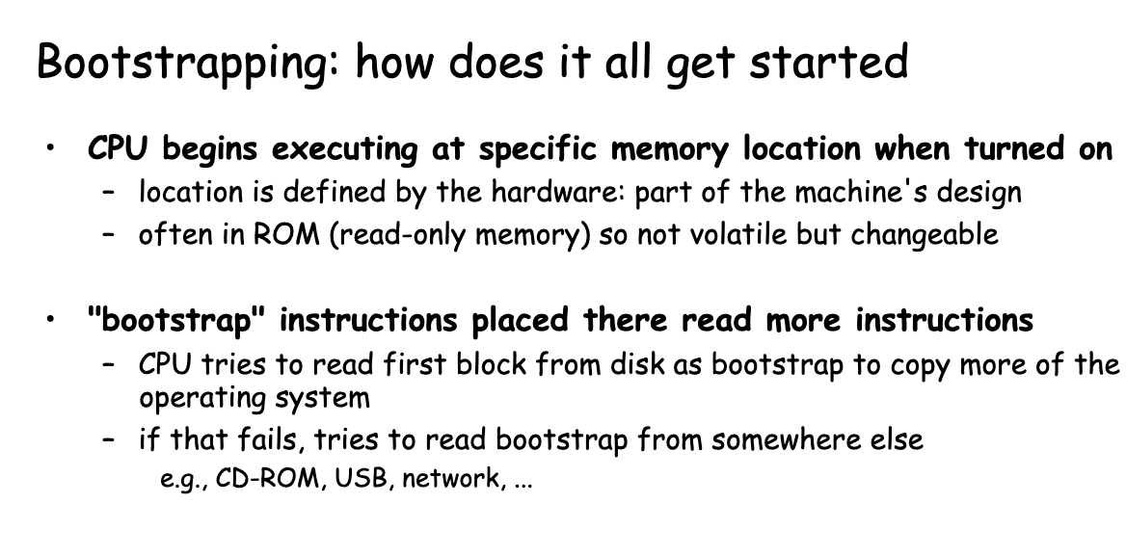
Bootstrapping

Slide 12
Software basics

Slide 13
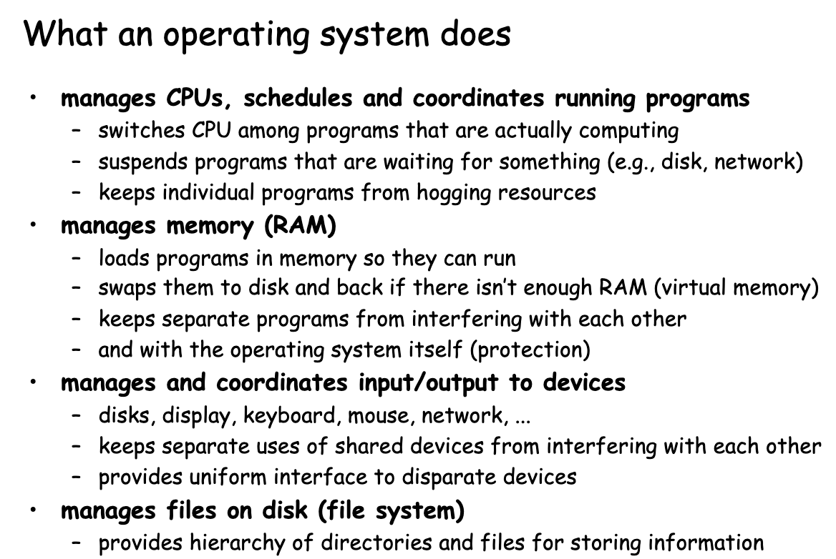
OS

Slide 14
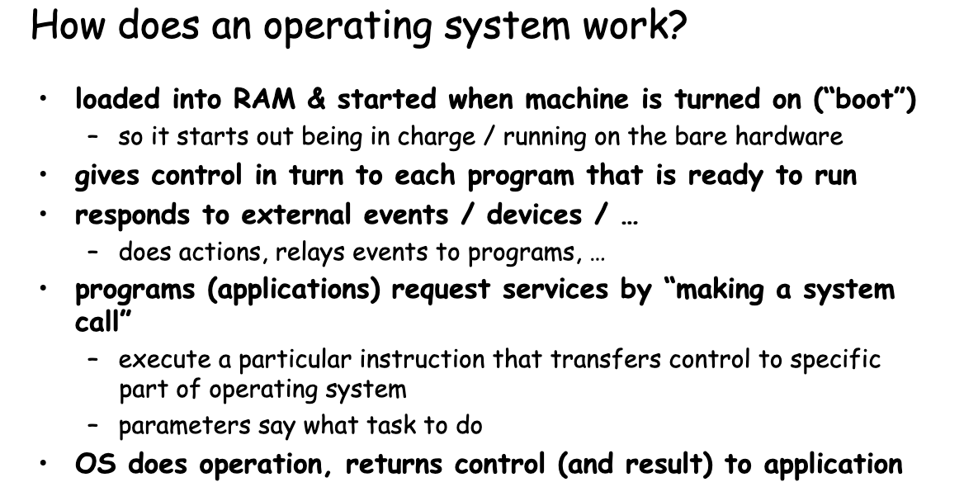
OS

Slide 15
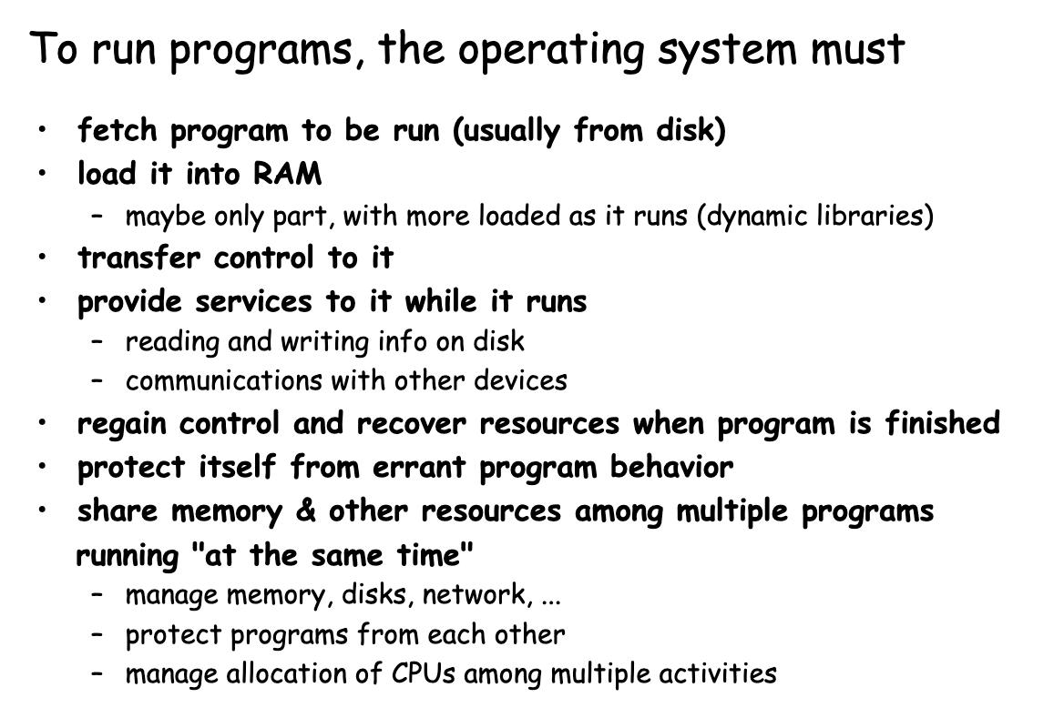
How to run programs?

Slide 16
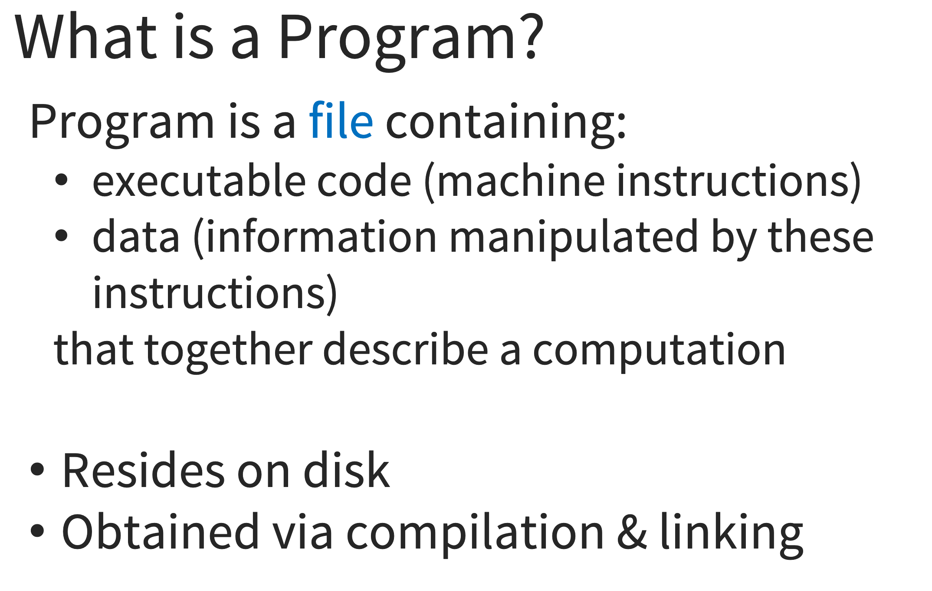
Programs

Slide 17
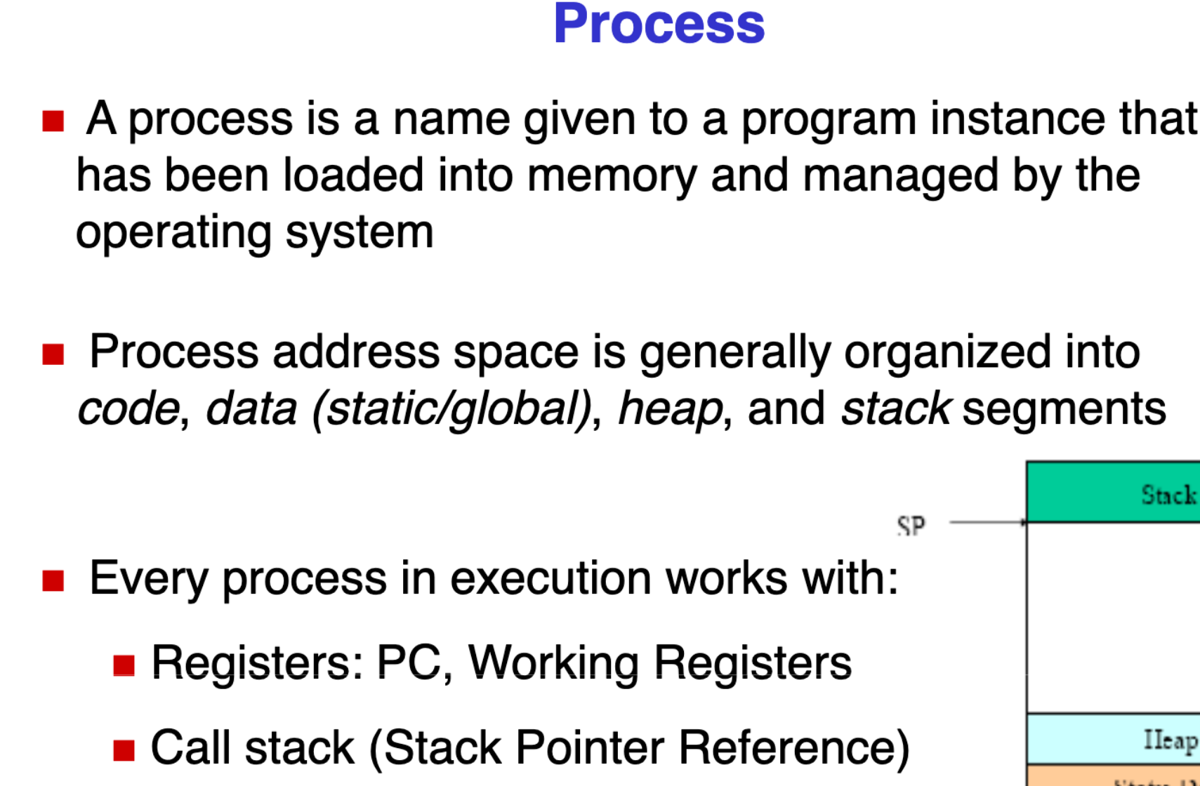
Process

Slide 18
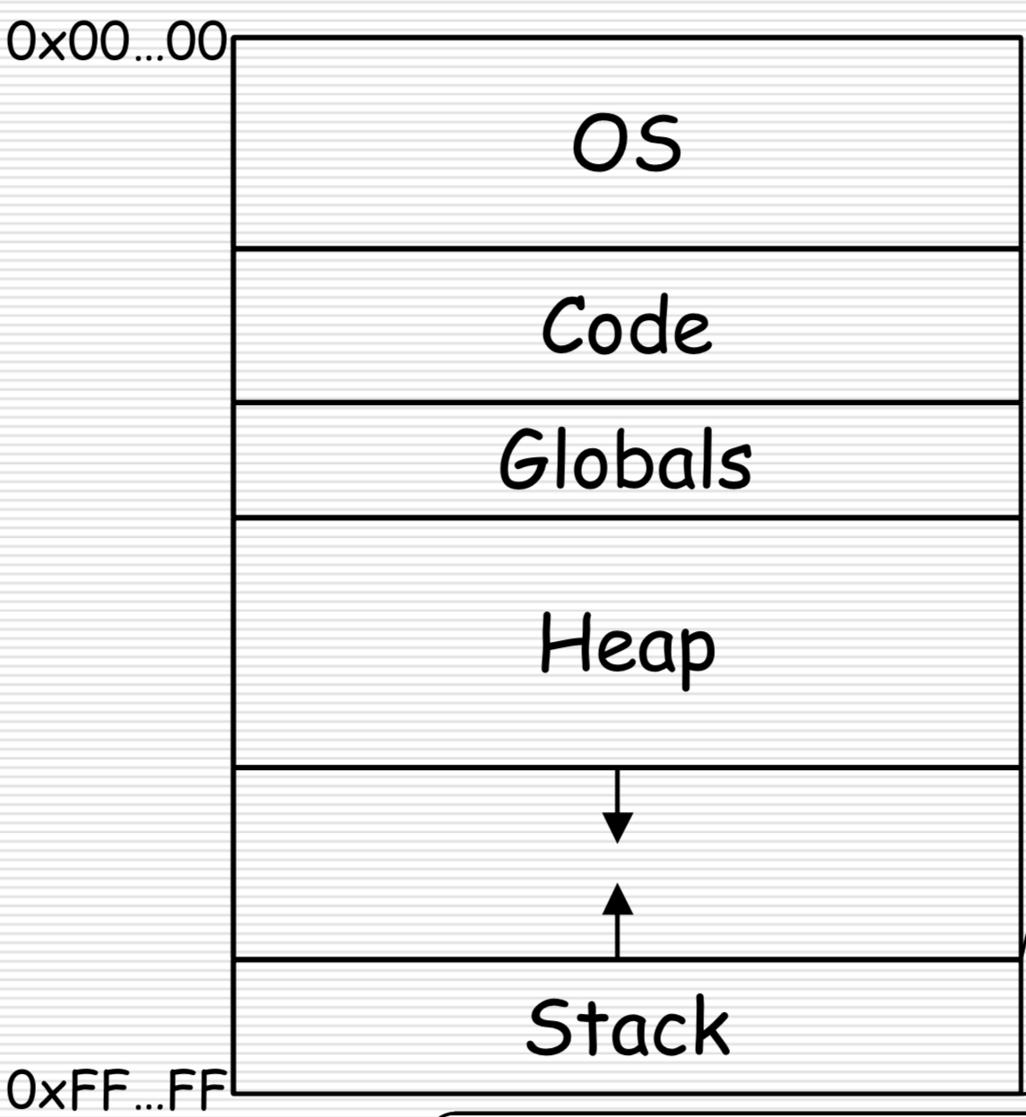
Process

Slide 19
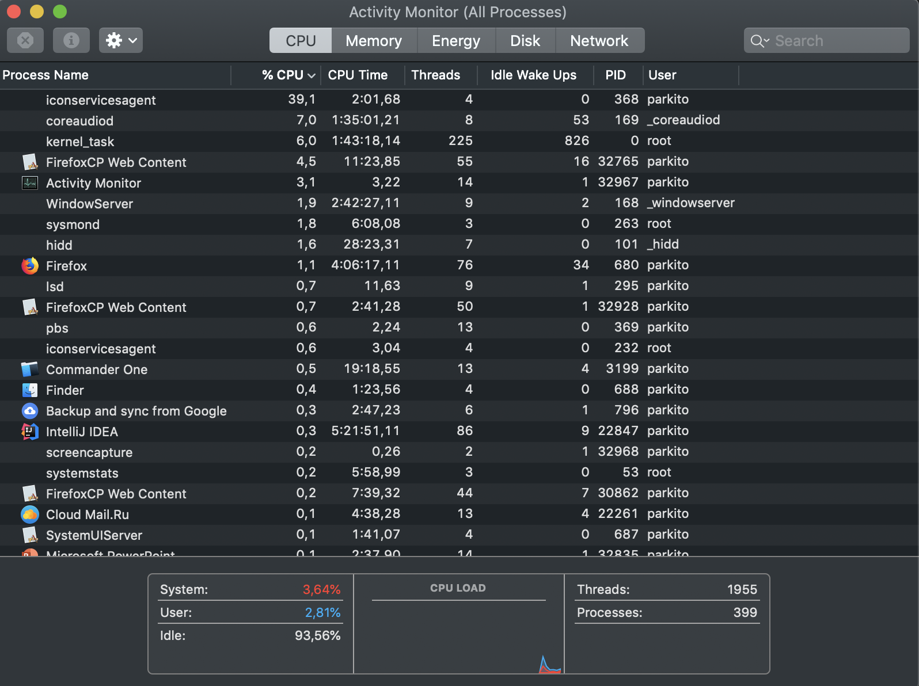
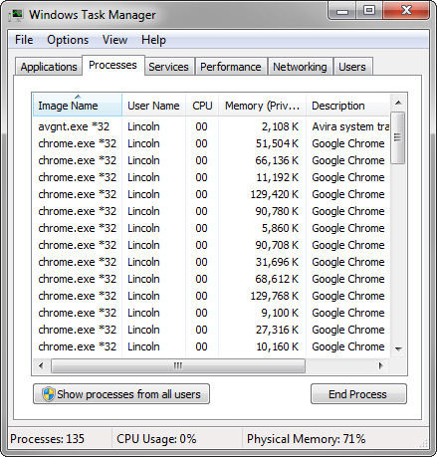
Processes

Slide 20
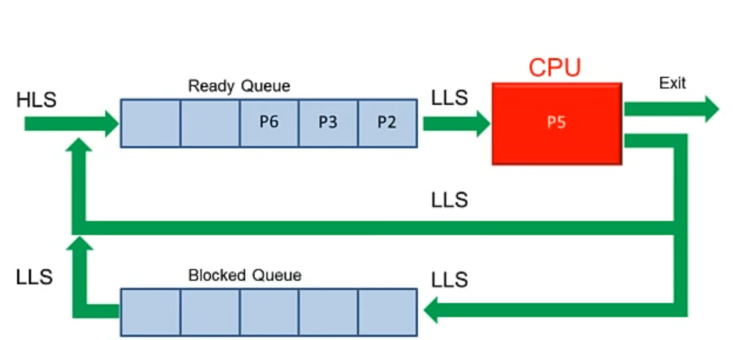
How processors work?

Slide 21
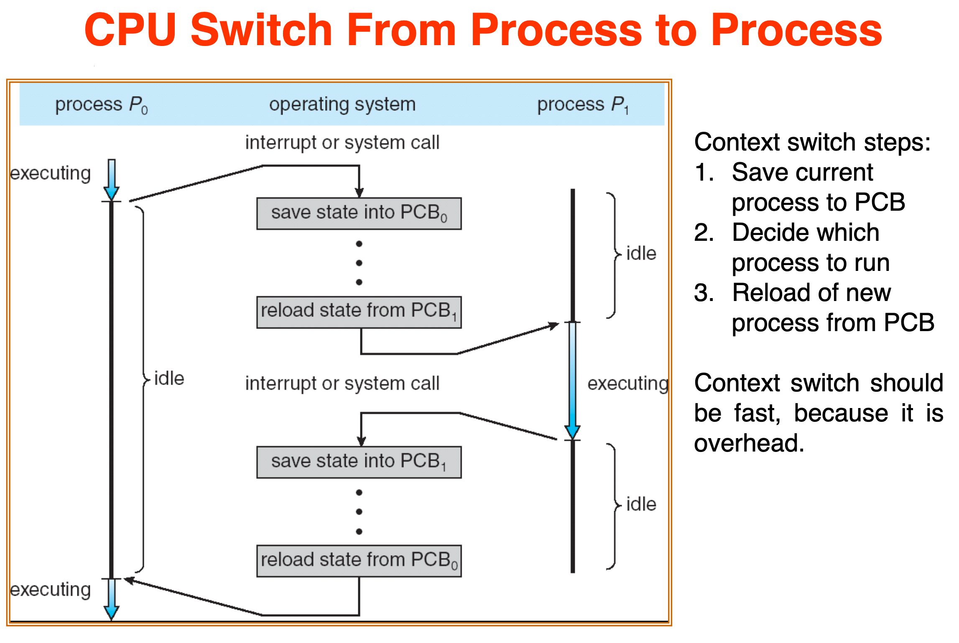
How processors work?

Slide 22
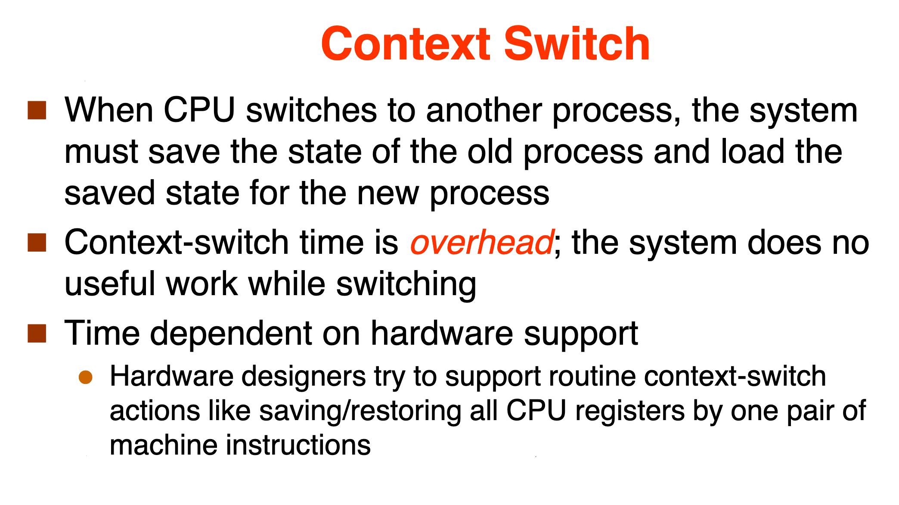
How processors work?

Slide 23
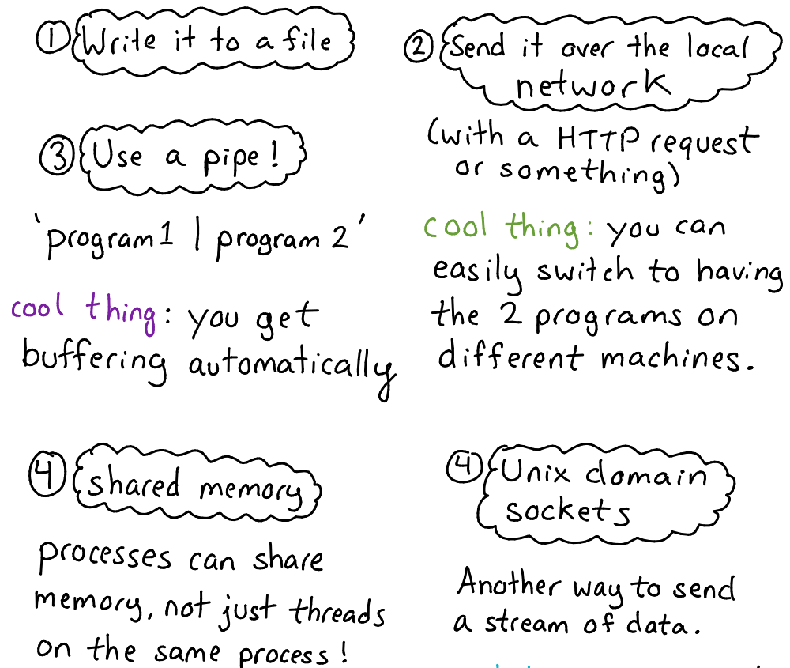
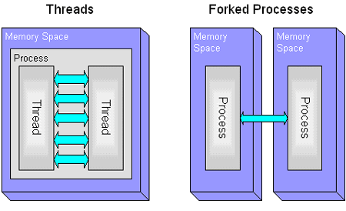
Inter-process communications

Slide 24
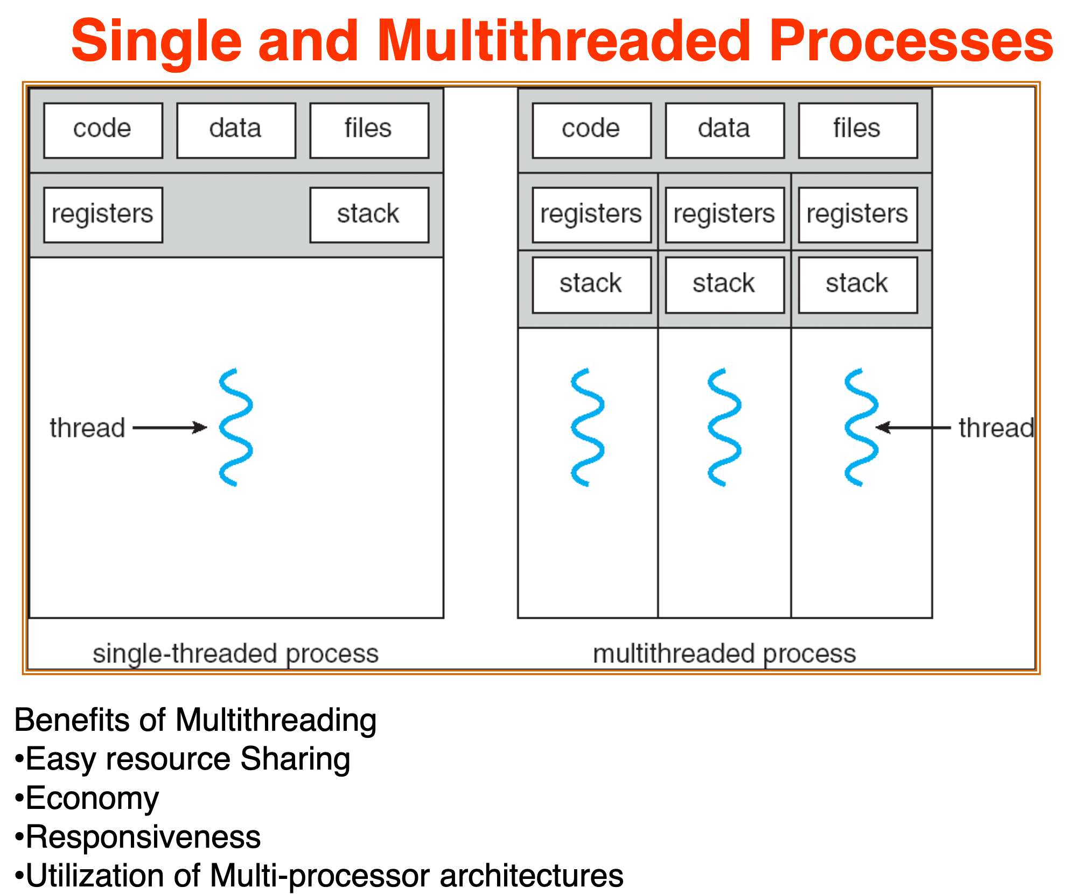
Threads

Slide 25
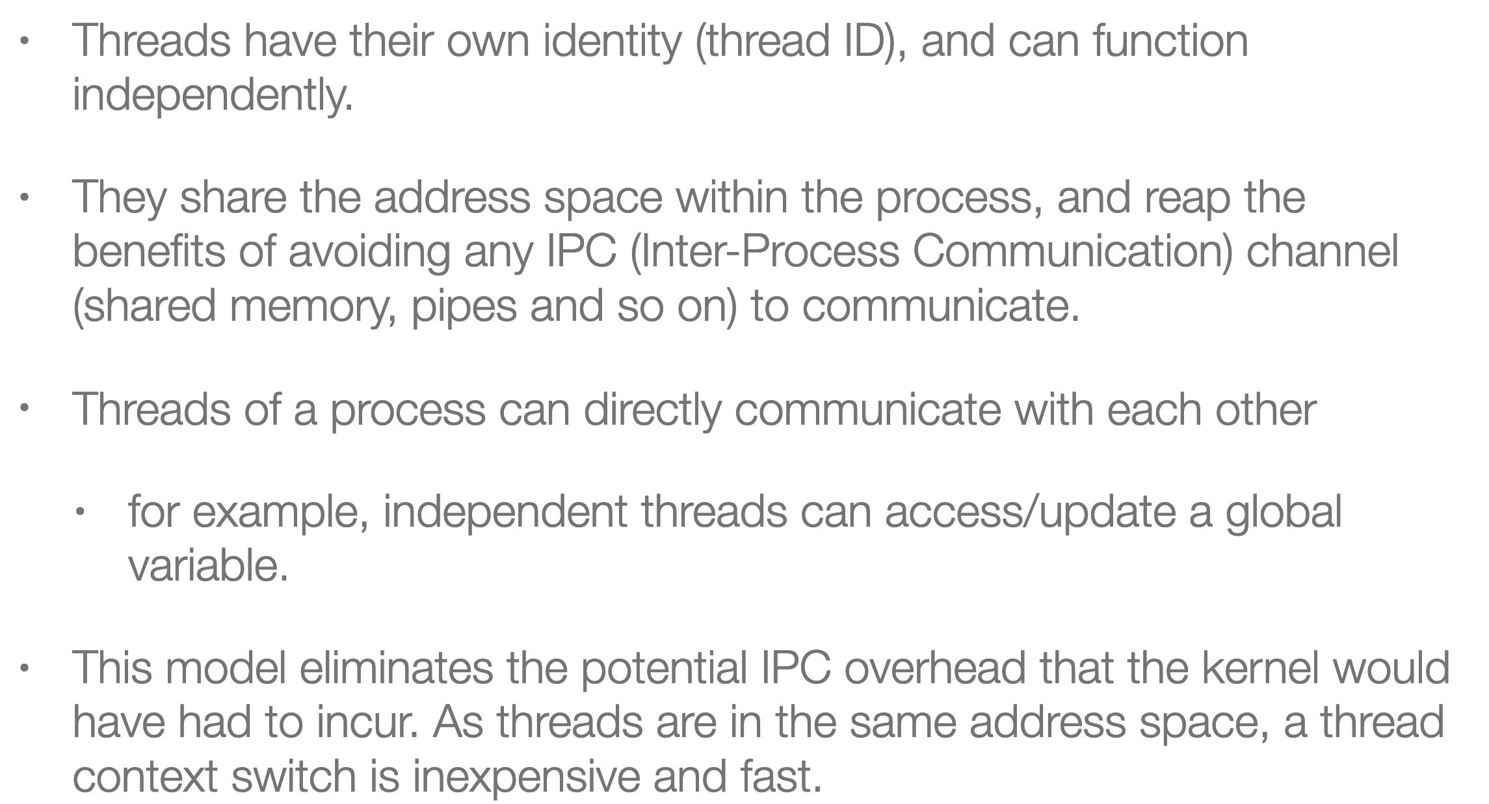
Threads

Slide 26
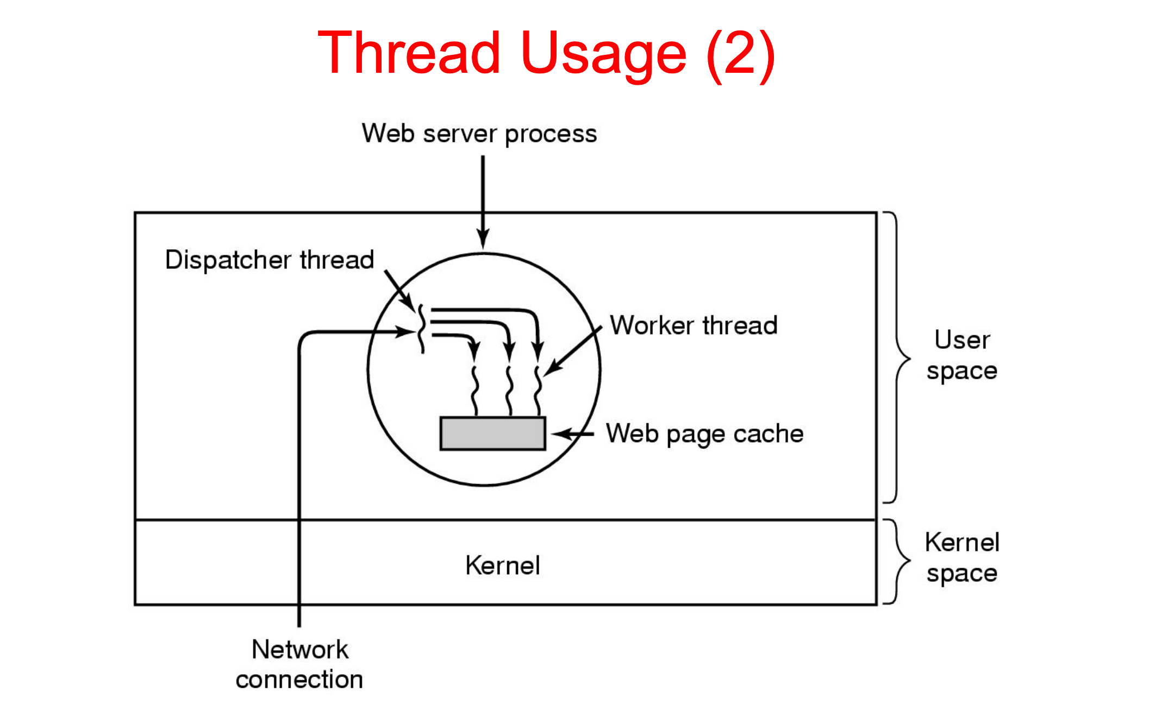
How processors work?

Slide 27
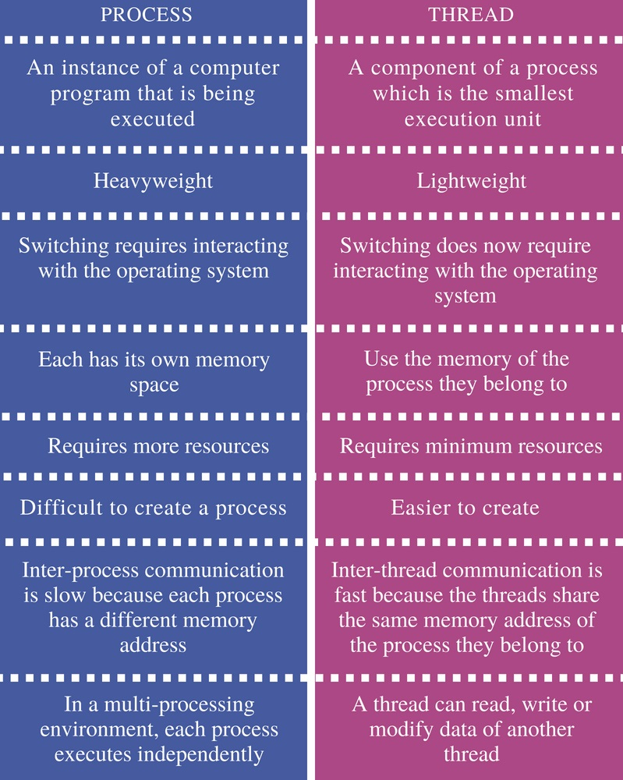
Inter-process communications

Slide 28
Java basics

Slide 29
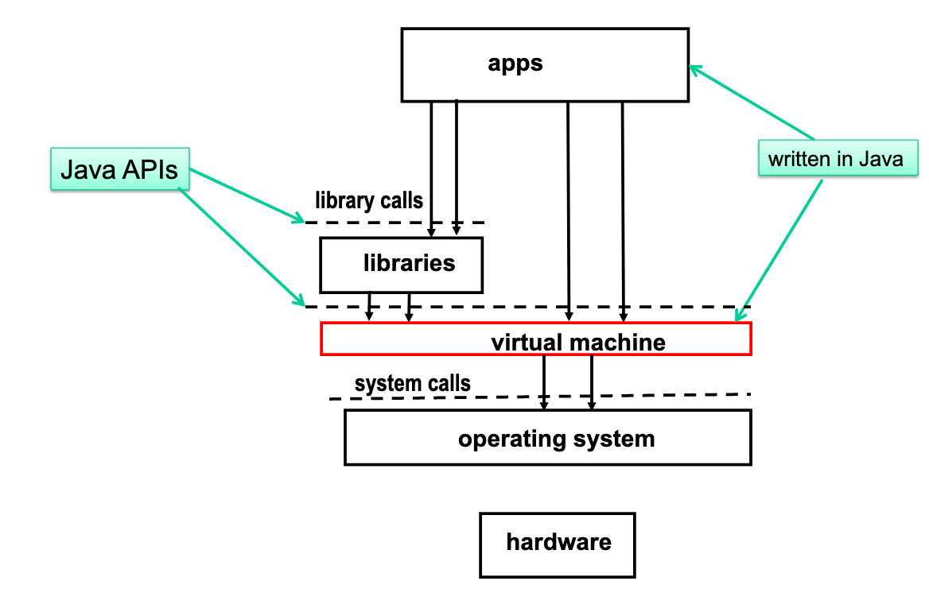
JVM execution architecture

Slide 30
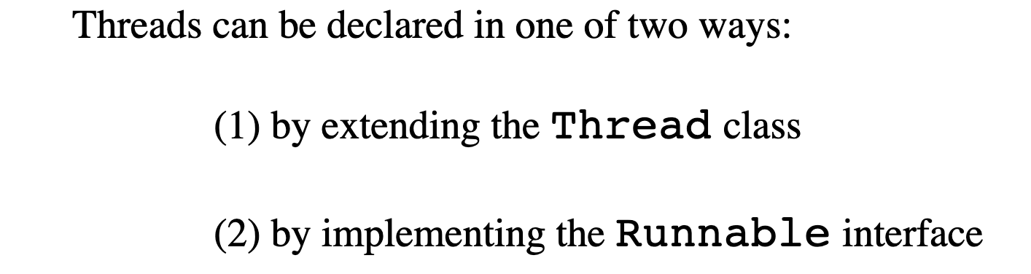
JVM execution architecture

Slide 31
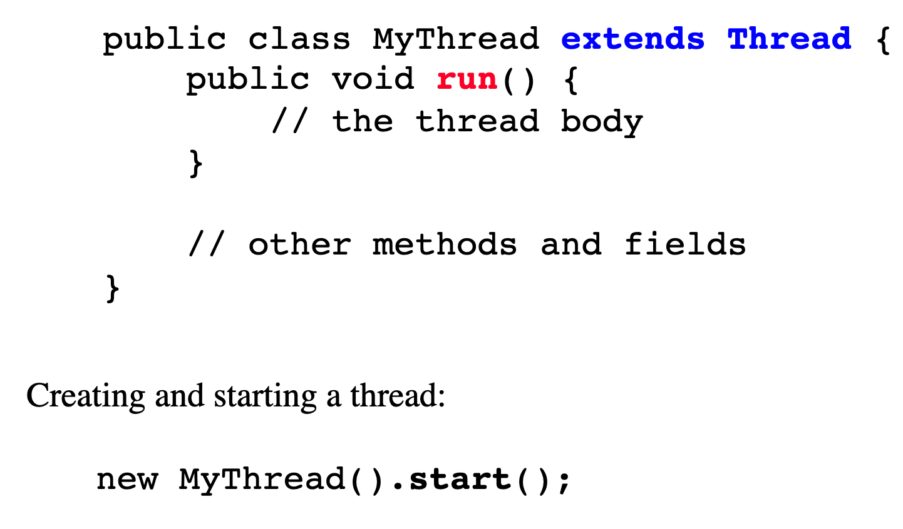
JVM execution architecture

Slide 32
JVM execution architecture

Slide 33
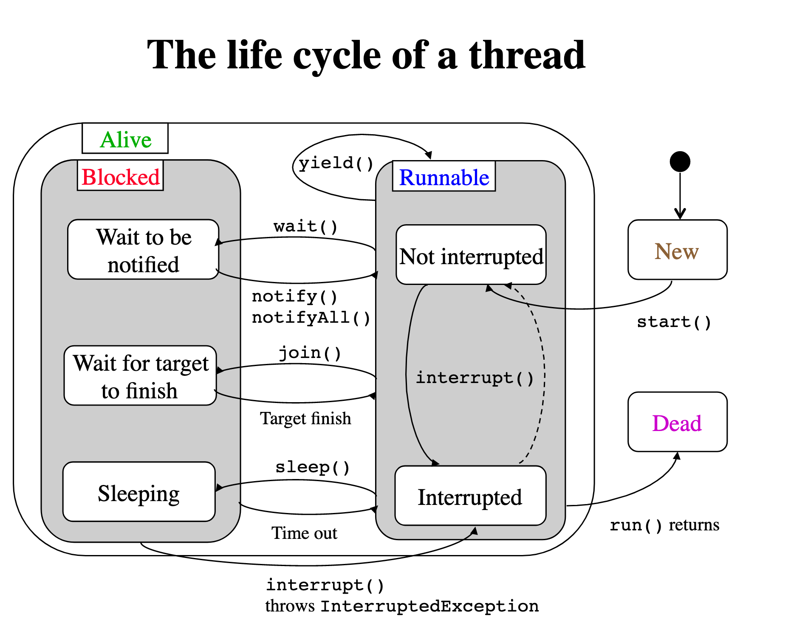
JVM execution architecture

Slide 34
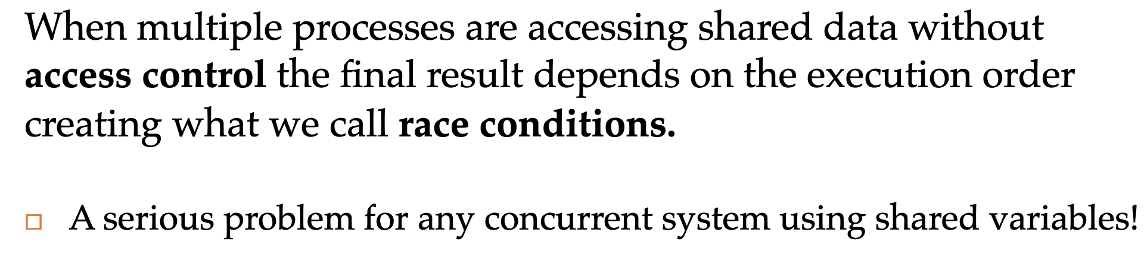
JVM execution architecture

Slide 35
How processors work?

Slide 36
Concurrent computing is a form of computing in which several computations are executed during overlapping time periods—concurrently—instead of sequentially (one completing before the next starts)
Definition

Slide 37
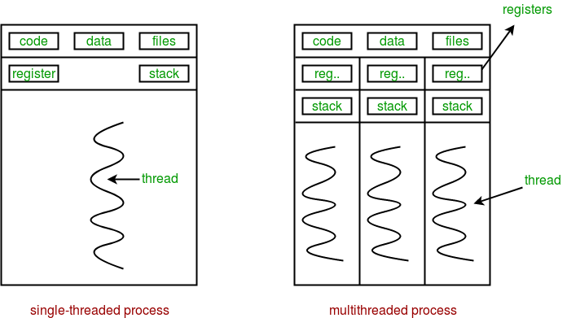
Sequential vs concurrent

Slide 38
Performance

Slide 39
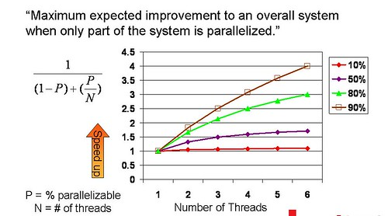
Amdahl's law

Slide 40
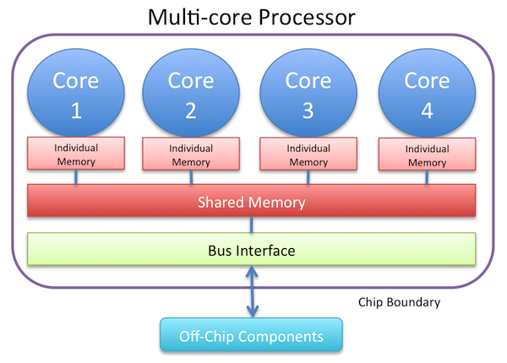
Resource utilization

Slide 41
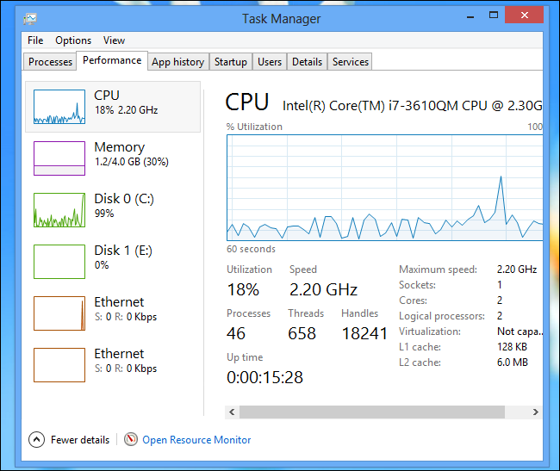
Resource utilization

Slide 42
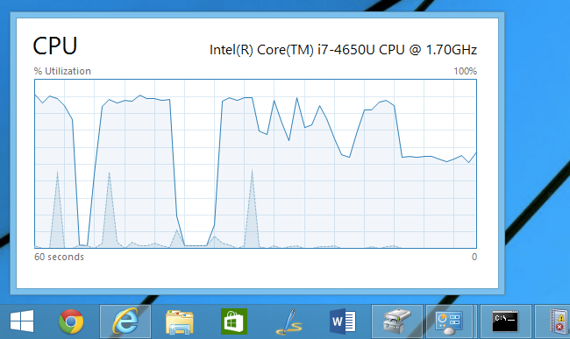
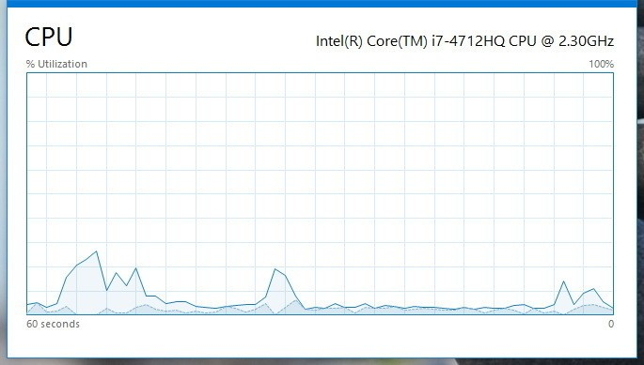
Resource utilization

Slide 43
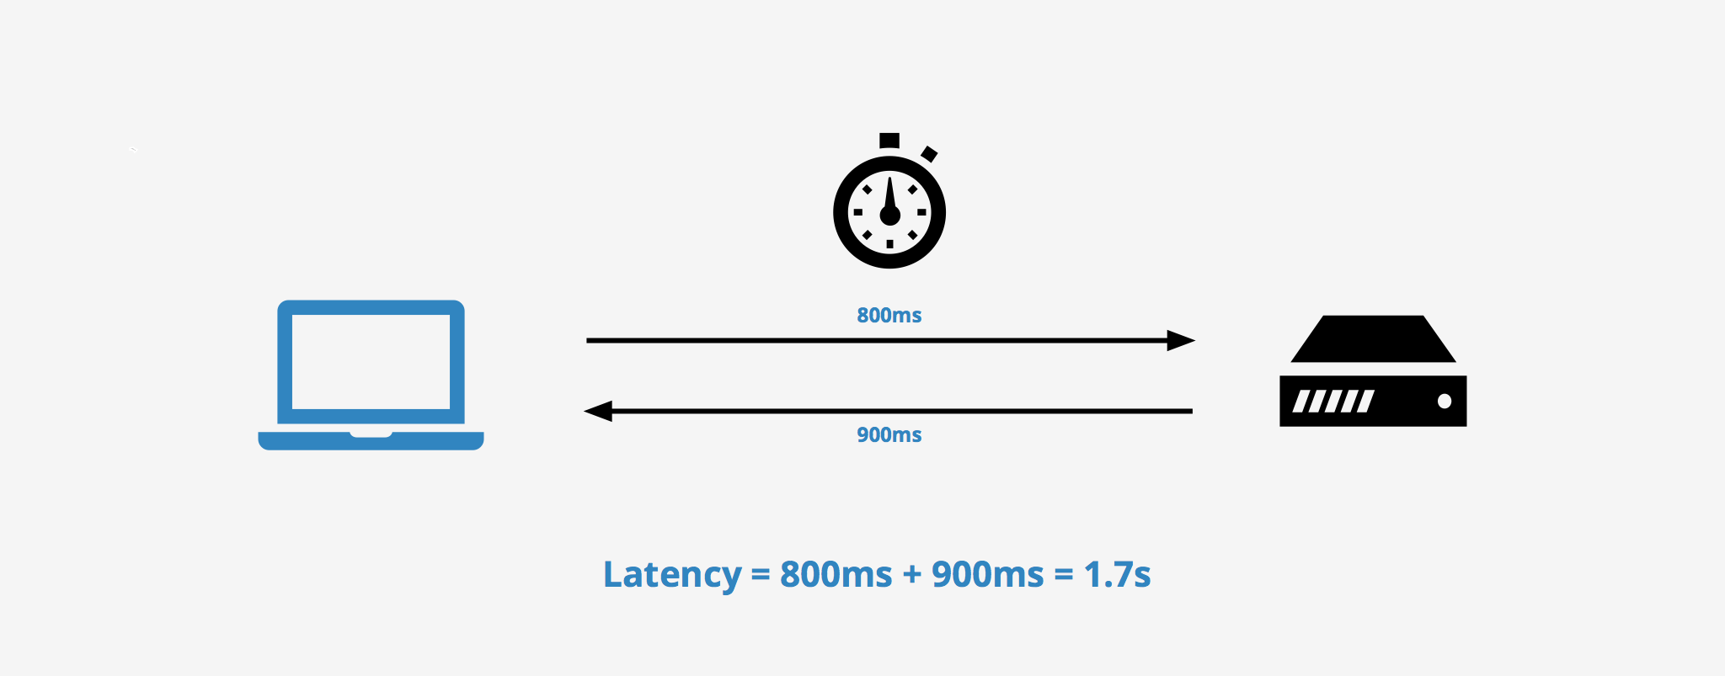
Latency

Slide 44

Modern way

Slide 45
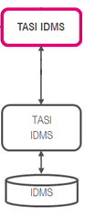
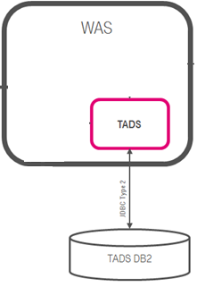

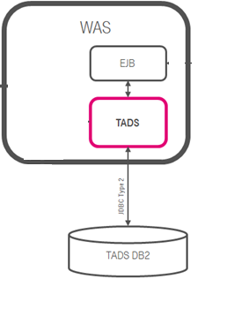
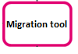

Concurrent Dijkstra algorithm

Slide 46
Multi thread migration

Slide 47
Single thread migration
7h21 min 1.7 r/s

Slide 48
Multi thread migration

Slide 49
Multi thread migration
7h21 min 1.7 r/s
28 min 23 r/s

Slide 50

The show begins

Slide 51
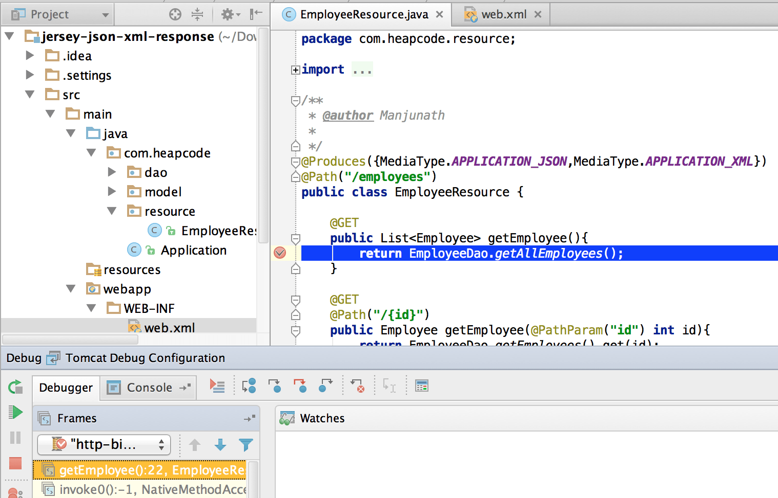
#1 Difficult to debug

Slide 52
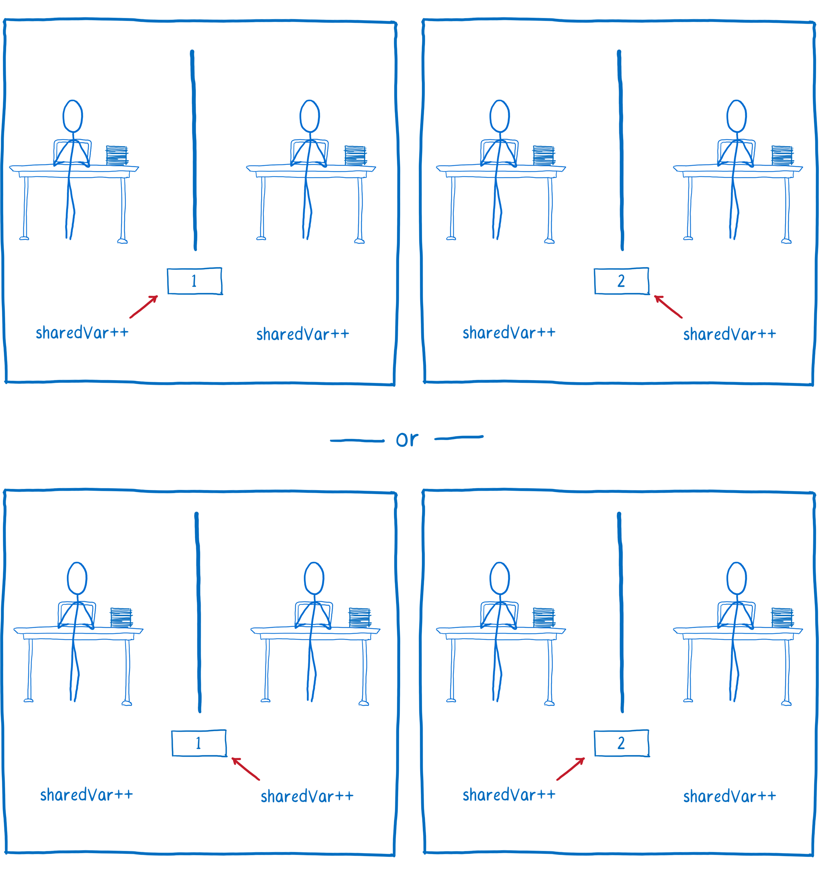
#2 Race condition

Slide 53
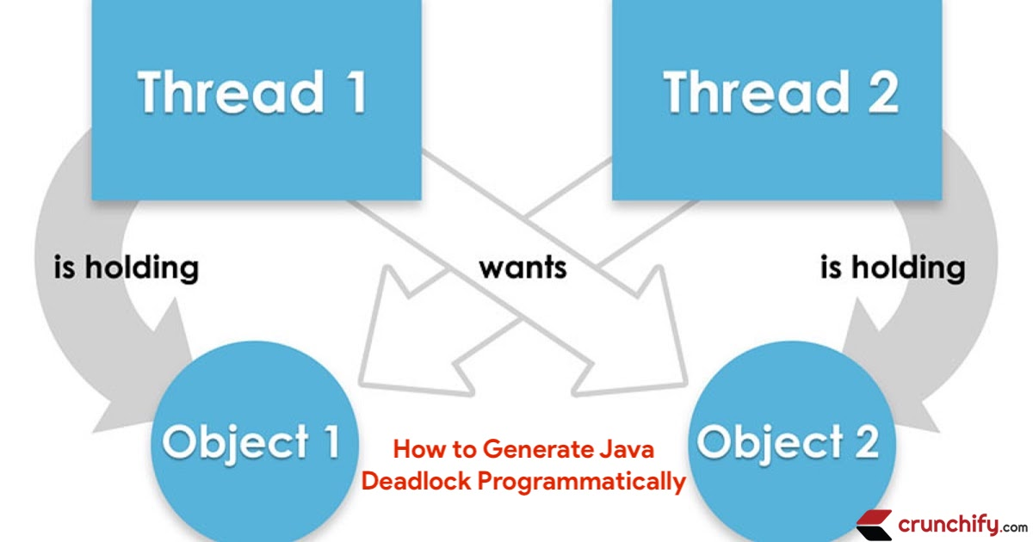
#3 Dead locks

Slide 54
Concurrency mad stuff
“But I don’t want to go among mad people," Alice remarked. - "Oh, you can’t help that," said the Cat: "we’re all mad here. I’m mad. You’re mad." - "How do you know I’m mad?" said Alice. - "You must be," said the Cat, "or you wouldn’t have come here.”
Alice's Adventures in
Wonderland by Lewis Carroll

Slide 55
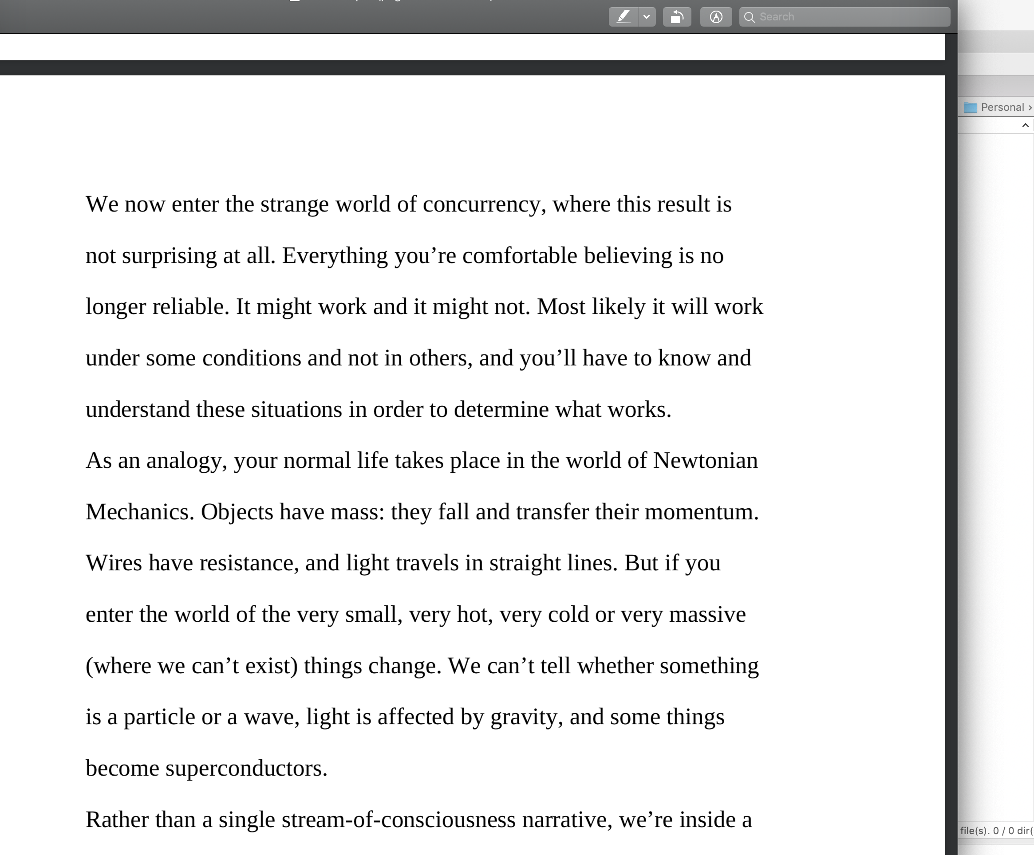

Dev practices
On Java 8 by Bruce Eckel

Slide 56
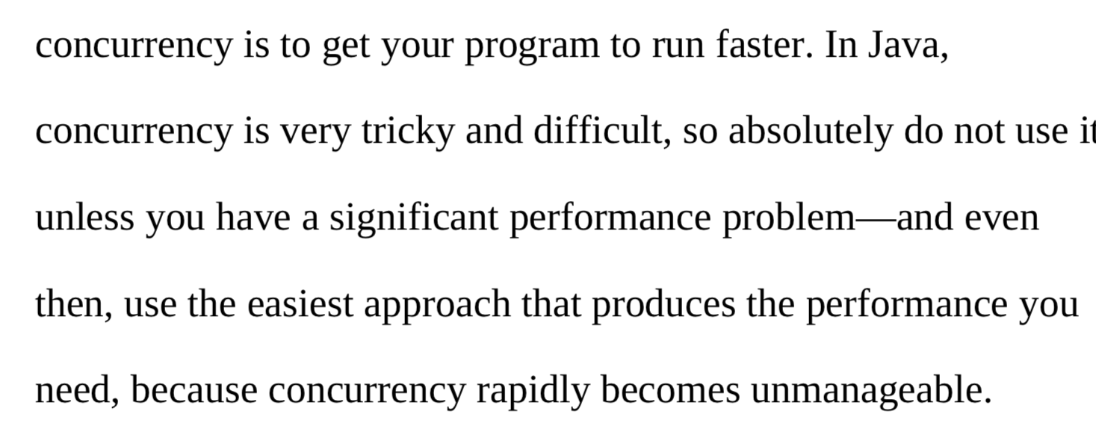
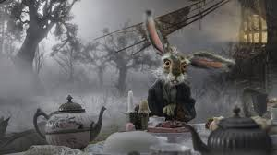
Dev practices
On Java 8 by Bruce Eckel

Slide 57
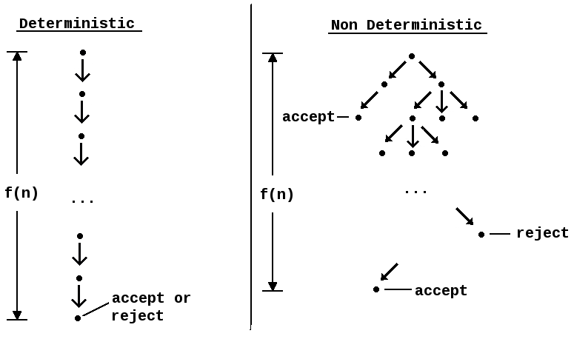
#4 Non deterministic behavior

Slide 58
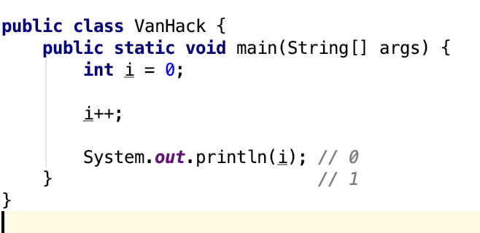
#4 Non deterministic behavior

Slide 59
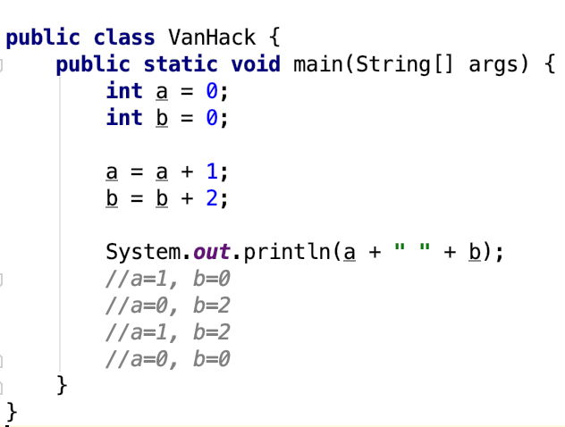
#4 Non deterministic behavior

Slide 60

#4 Non deterministic behavior

Slide 61
Are you still here?
Twas brillig, and the slithy toves Did gyre and gimble in the wabe: All mimsy were the borogoves, And the mome raths outgrabe
Jabberwocky by Lewis Carroll

Slide 62

Let’s continue?

Slide 63

#5 Performance degradation

Slide 64

#5 Performance degradation

Slide 65

#6 OS limitation

Slide 66

Stop it? Hell no…

Slide 67

#7 Hardware unpredictable optimizations

Slide 68

Concurrency in real world
On Java 8 by Bruce Eckel

Slide 69
Conclusion
Concurrency is powerful practice, you can achieve a lot using it
Don’t use concurrency if you can avoid it
Use best practices by experts
Use frameworks with big professional community
Minimize synchronization and data sharing
Perform load and stress testing
Use as much as possible existed solutions
Don’t forget about mad world and wonders

Slide 70
Resources
Java concurrency in practice (Brian Goetz )
On Java 8 (Bruce Eckel)
The Art of Multiprocessor Programming (Maurice Herlihy , Nir Shavit )

Slide 71

THANK YOU!
artyom-karnov@yandex.ru, Saint-Petersburg, 2019

